Slide 1
Module-II
CSET333: Problem Solving Using C

Slide 2

#define in C
In C programming, #define is a preprocessor directive that is used to define macros.
The macros are the identifiers defined by #define which are replaced by their value before compilation.
We can define constants and functions like macros using #define.
Syntax of C #define
For Defining Constants
For Defining Expressions
For Defining Expression with Parameters
CSET333: Problem Solving Using C

Slide 3
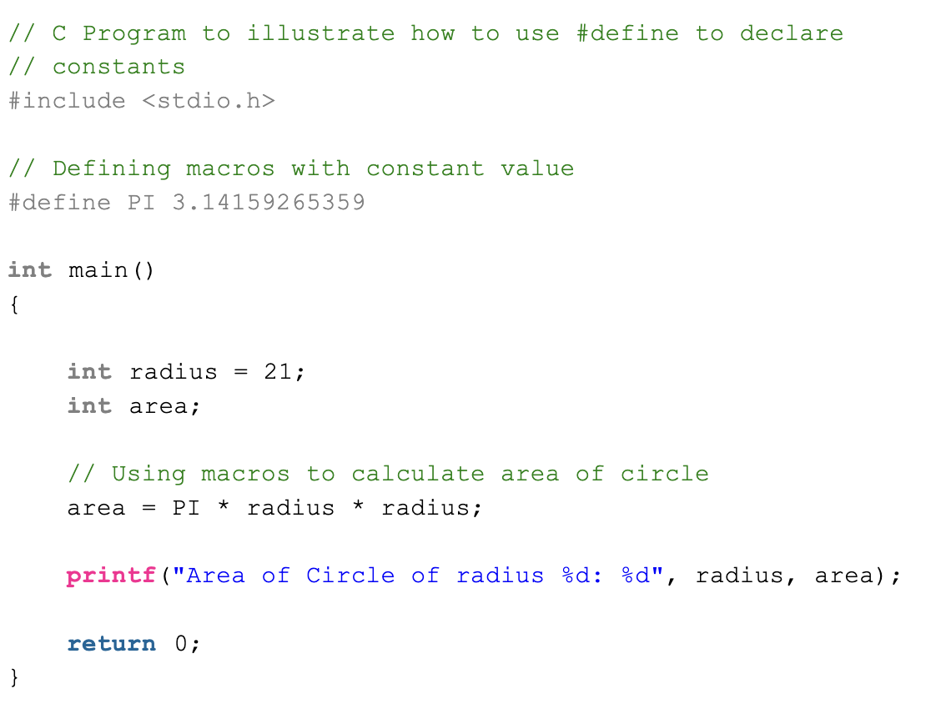
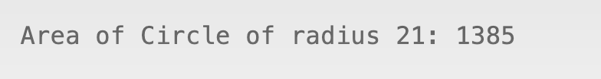
Example:
Output:
CSET333: Problem Solving Using C

Slide 4
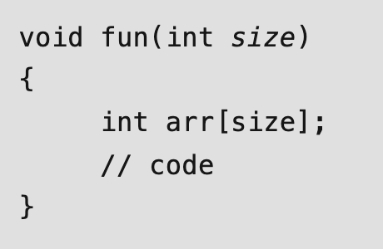
Variable Length Arrays in C
In C, variable length arrays (VLAs) are also known as runtime-sized or variable-sized arrays. The size of such arrays is defined at run-time.
Variably modified types include variable-length arrays and pointers to variable-length arrays. Variably changed types must be declared at either block scope or function prototype scope.
Syntax
CSET333: Problem Solving Using C

Slide 5
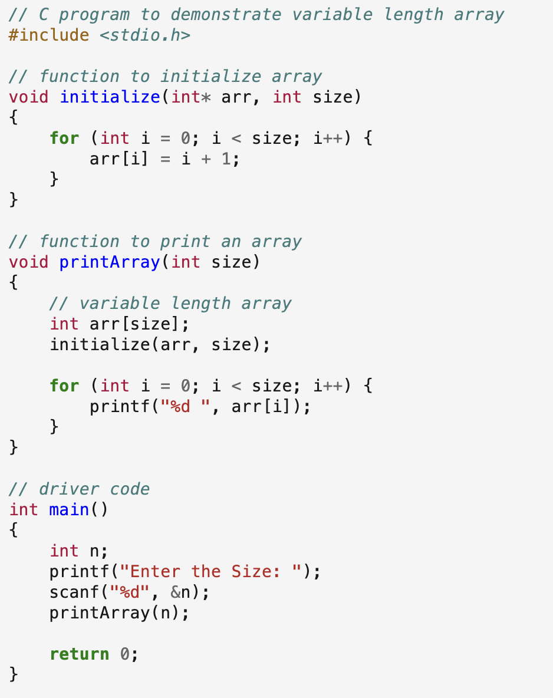
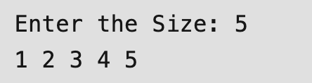
Example:
Output:
CSET333: Problem Solving Using C

Slide 6
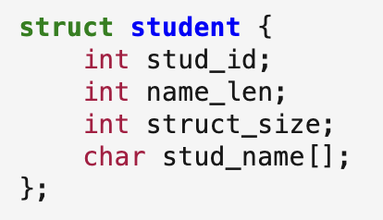
Flexible Array Members in a structure in C
For the structures in C programming language from C99 standard onwards, we can declare an array without a dimension and whose size is flexible in nature.
Such an array inside the structure should preferably be declared as the last member of the structure and its size is variable(can be changed at runtime).
The structure must contain at least one more named member in addition to the flexible array member.
What must be the size of the structure below?
CSET333: Problem Solving Using C

Slide 7

Const Qualifier in C
Using the const qualifier in C is a good practice when we want to ensure that some values should remain constant and should not be accidentally modified.
In C programming, the const qualifier can be used in different contexts to provide various behaviors. Here are some different use cases of the const qualifier in C:
1. Constant Variables
In this case, const is used to declare a variable var as a constant with an initial value of 100. The value of this variable cannot be modified once it is initialized.
CSET333: Problem Solving Using C

Slide 8
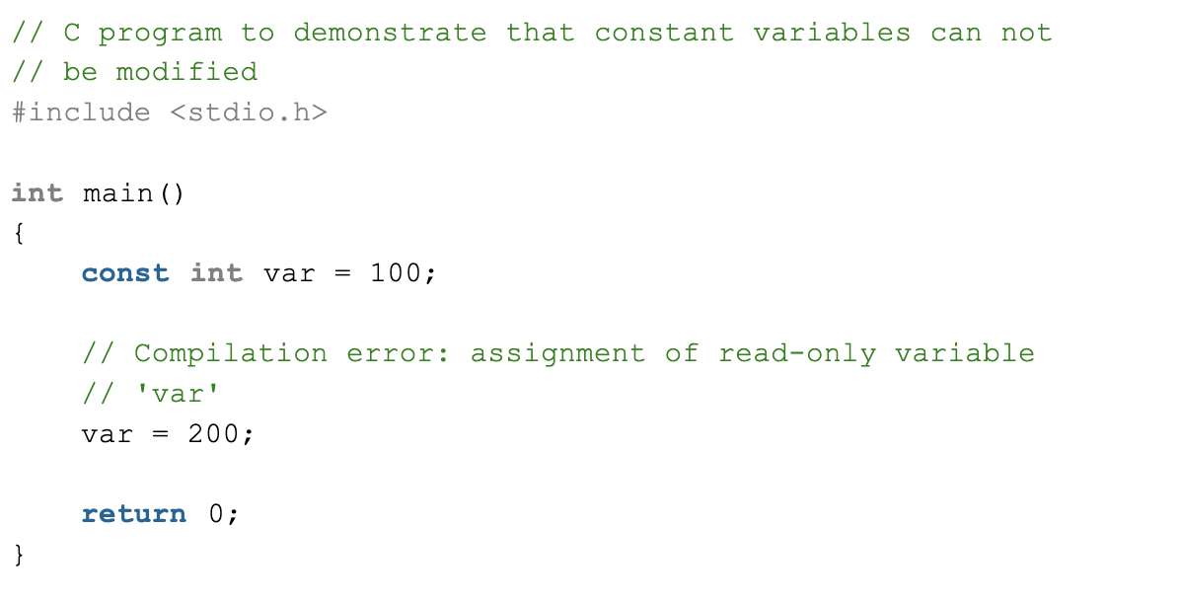
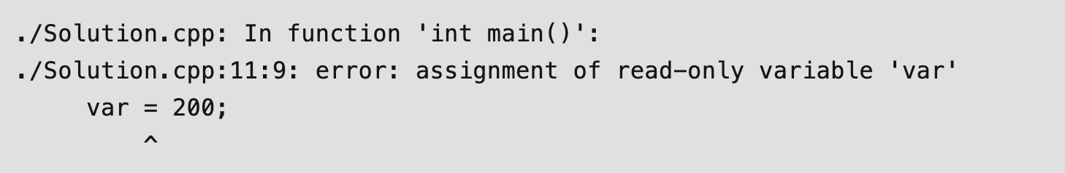
Example:
Output:
CSET333: Problem Solving Using C

Slide 9
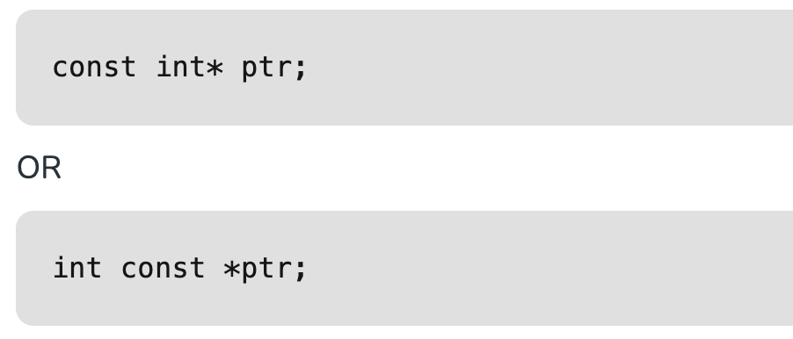
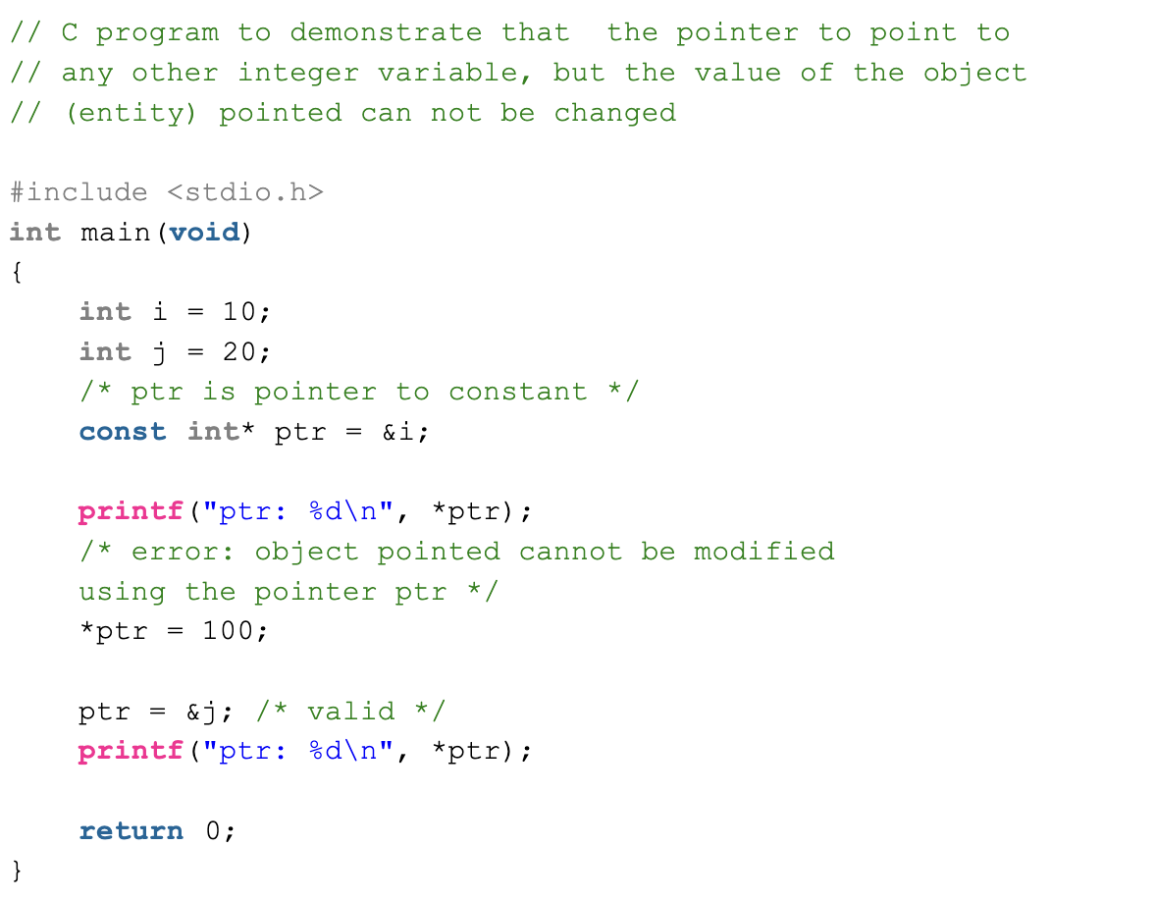
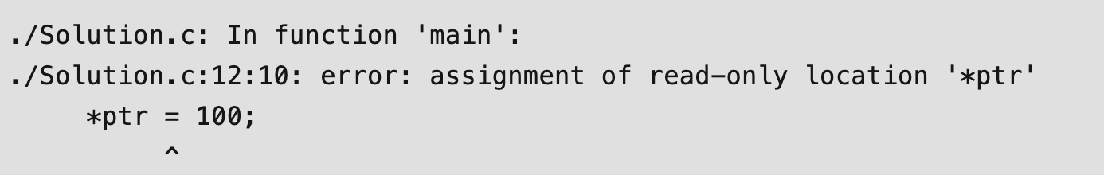
2. Pointer to Constant
Example:
Output:
CSET333: Problem Solving Using C

Slide 10

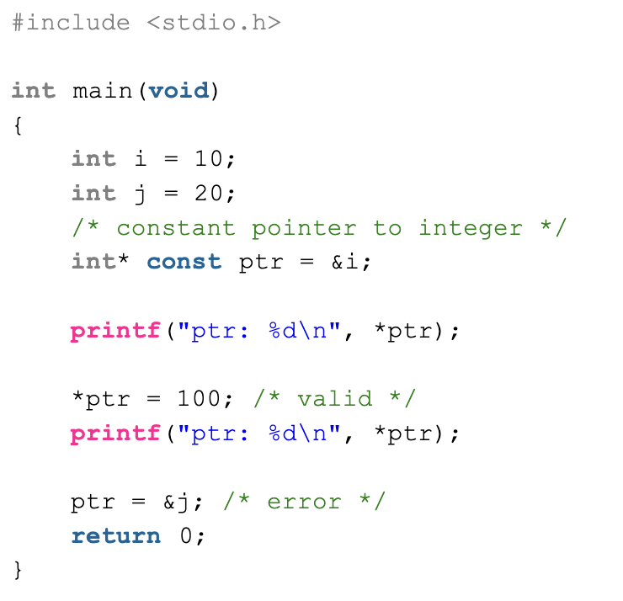
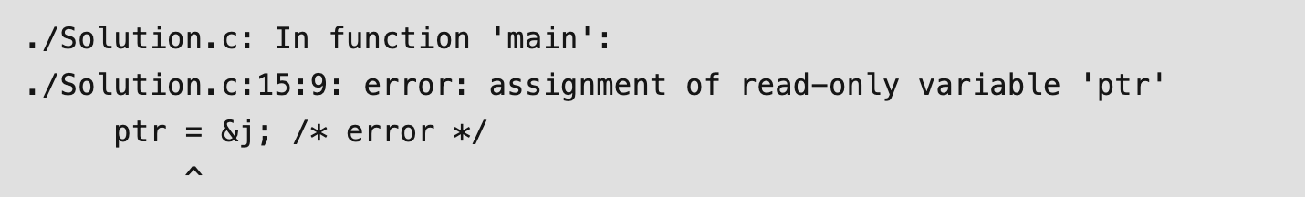
3. Constant Pointer to Variable
The above declaration is a constant pointer to an integer variable, which means we can change the value of the object pointed by the pointer, but cannot change the pointer to point to another variable.
Example:
Output:
CSET333: Problem Solving Using C

Slide 11
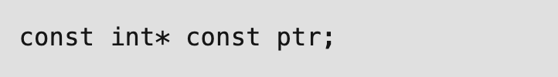
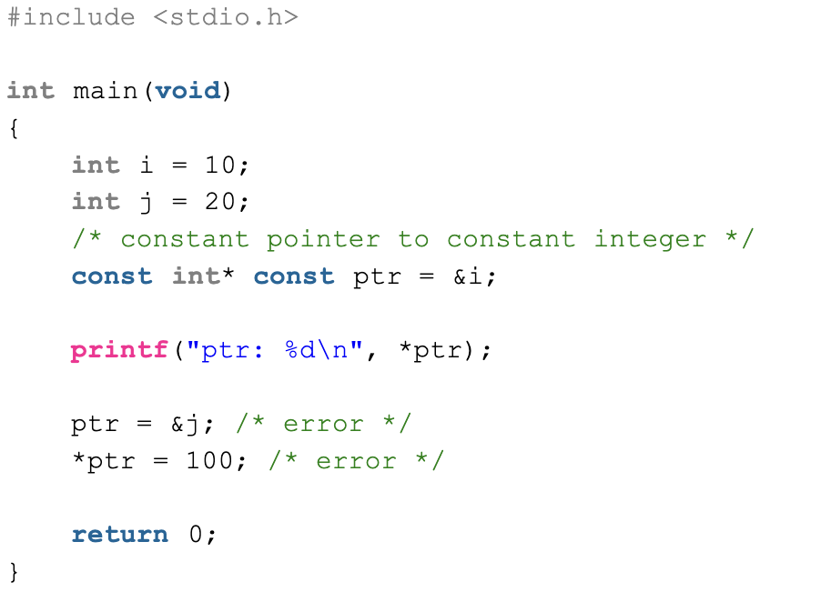
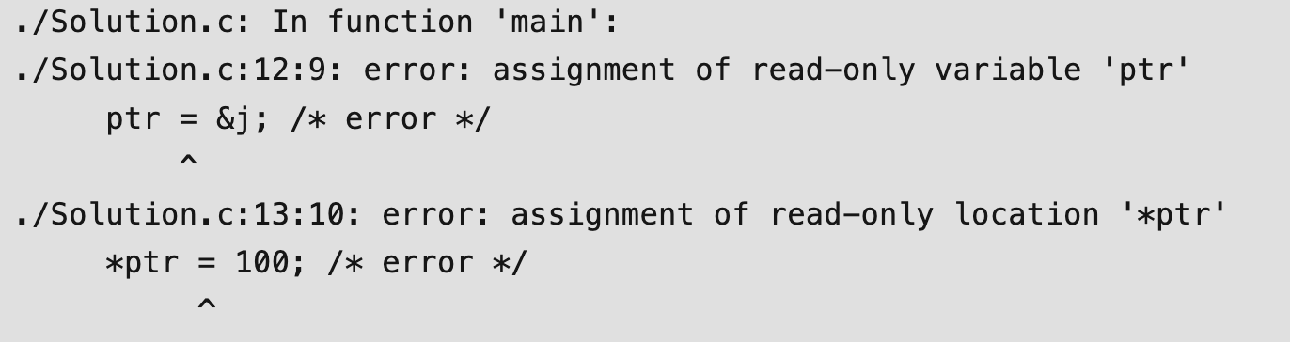
4. Constant Pointer to Constant
Example:
Output:
CSET333: Problem Solving Using C

Slide 12
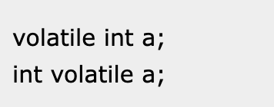
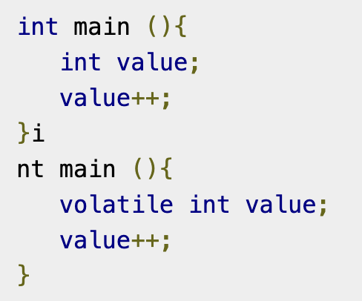
Volatile qualifier in C
The volatile qualifier is applied to a variable when we declare it.
It is used to tell the compiler, that the value may change at any time.
These are some properties of volatile:
  The volatile keyword cannot remove the memory assignment
  It cannot cache the variables in register.
  The value cannot change in order of assignment.
Let us see, how we can use the volatile keyword:
Example:
CSET333: Problem Solving Using C

Slide 13
Restrict qualifier in C
restrict keyword is mainly used in pointer declarations as a type qualifier for pointers.
It doesn’t add any new functionality. It is only a way for the programmer to inform about an optimization that the compiler can make.
When we use restrict with a pointer ptr, it tells the compiler that ptr is the only way to access the object pointed by it, in other words, there’s no other pointer pointing to the same object i.e. restrict keyword specifies that a particular pointer argument does not alias any other and the compiler doesn’t need to add any additional checks.
If a programmer uses restrict keyword and violates the above condition, the result is undefined behavior.
restrict is not supported by C++. It is a C-only keyword.
CSET333: Problem Solving Using C

Slide 14
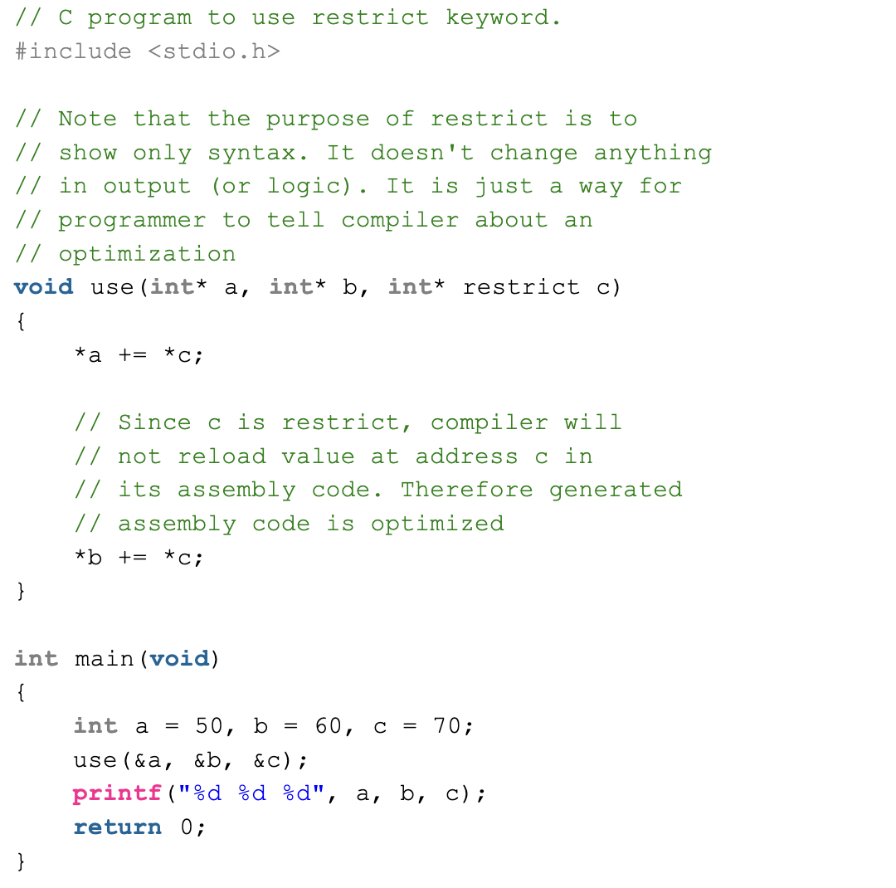

Example:
Output:
CSET333: Problem Solving Using C

Slide 15
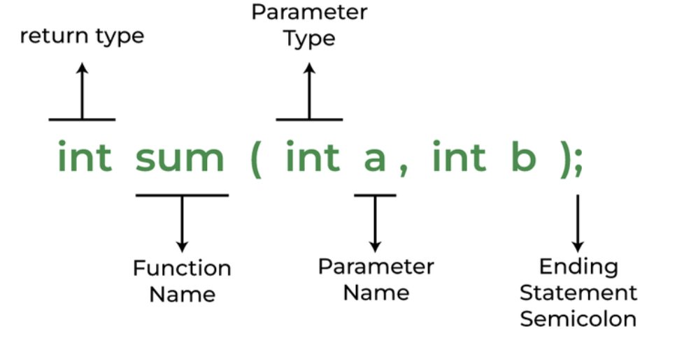
C Functions
Syntax of Functions in C
The syntax of function can be divided into 3 aspects:
  Function Declaration
  Function Definition
  Function Calls
1. Function Declarations
Syntax:
Example:
CSET333: Problem Solving Using C

Slide 16
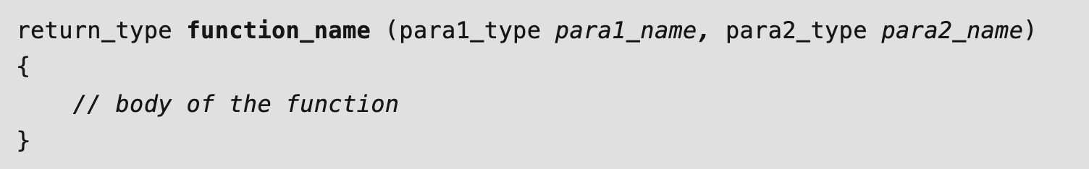
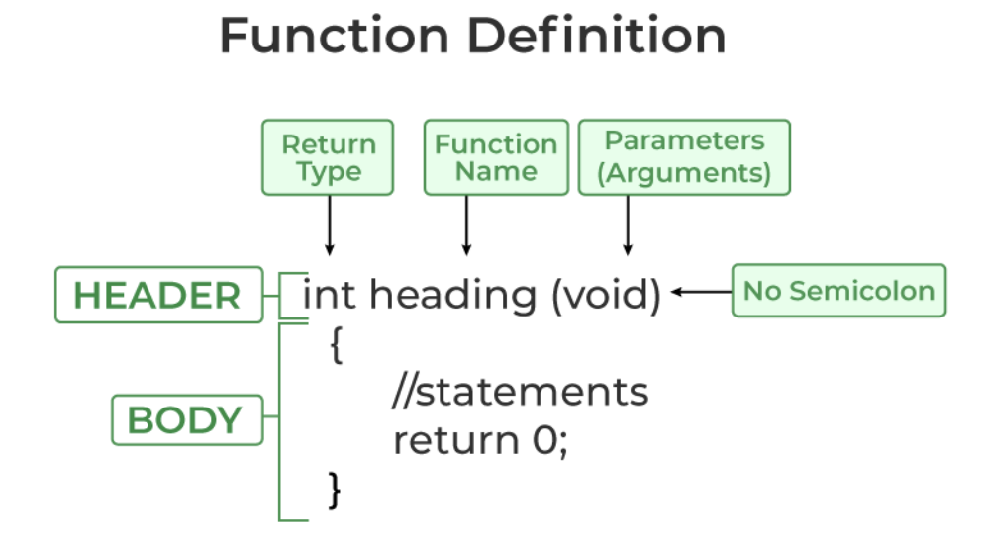
2. Function Definition
CSET333: Problem Solving Using C

Slide 17
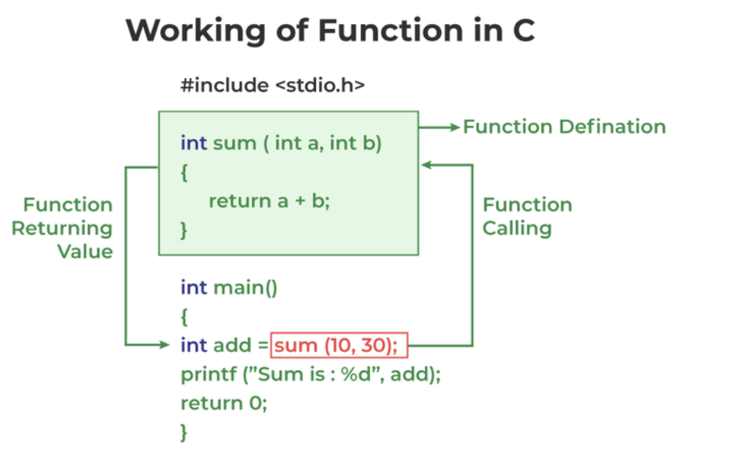
3. Function Call
A function call is a statement that instructs the compiler to execute the function. We use the function name and parameters in the function call.
CSET333: Problem Solving Using C

Slide 18
Parameter Passing Techniques in C
Terminology
Formal Parameter: A variable and its type as it appears in the prototype of the function or method.
Actual Parameter: The variable or expression corresponding to a formal parameter that appears in the function or method call in the calling environment.
Modes:
  IN: Passes info from caller to the callee.
  OUT: Callee writes values in the caller.
  IN/OUT: The caller tells the callee the value of the variable, which the callee may update.
CSET333: Problem Solving Using C

Slide 19
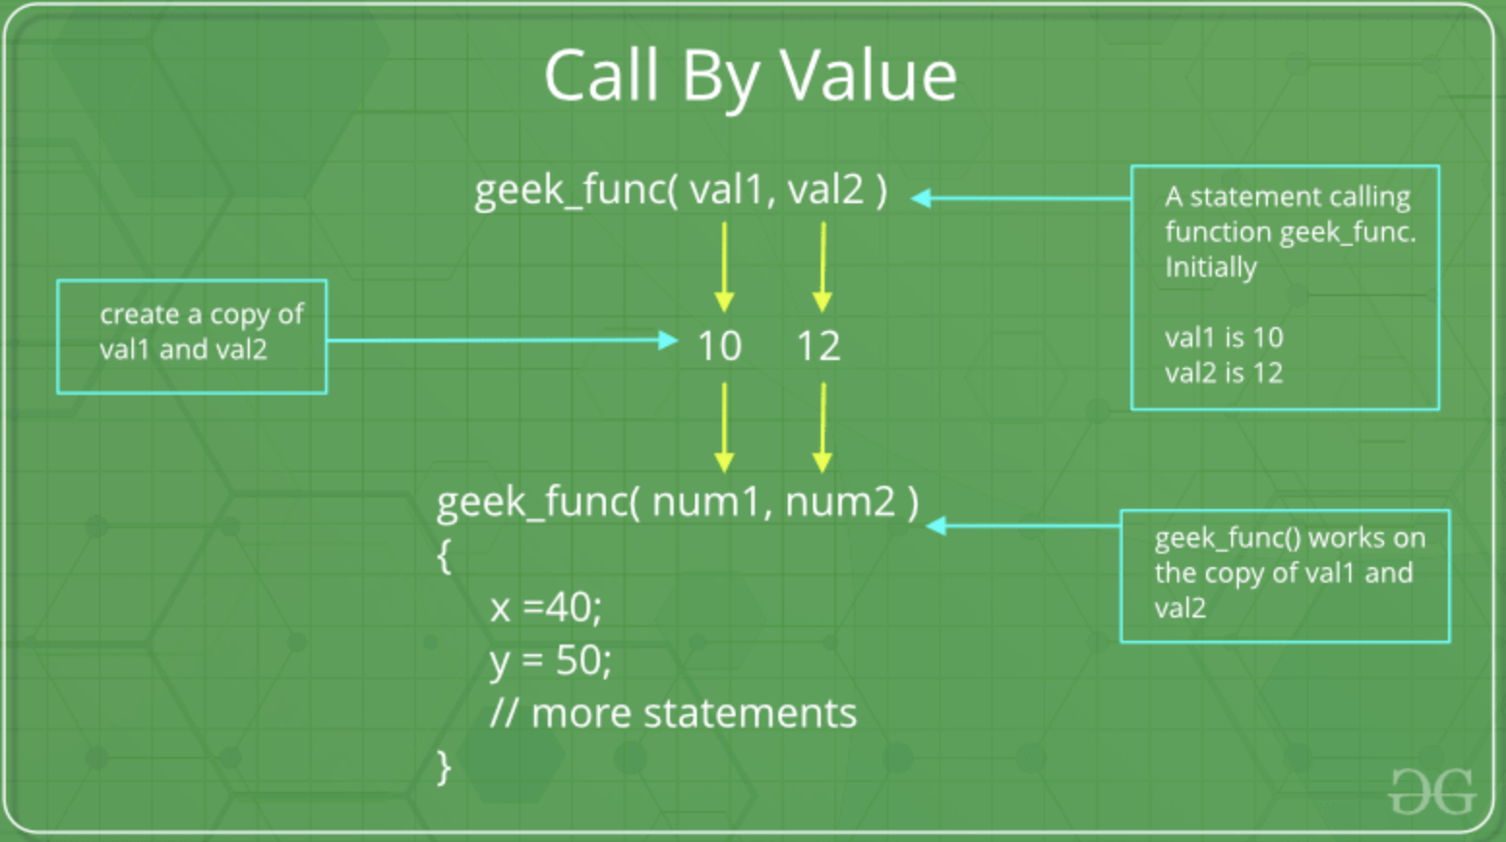
1. Pass By Value
Any modifications to the formal parameter variable inside the called function or method affect only the separate storage location and will not be reflected in the actual parameter in the calling environment. This method is also called call by value.
CSET333: Problem Solving Using C

Slide 20
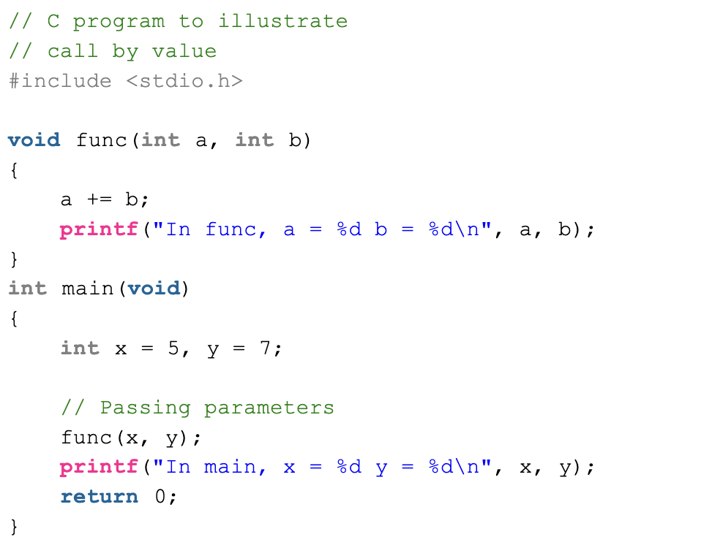
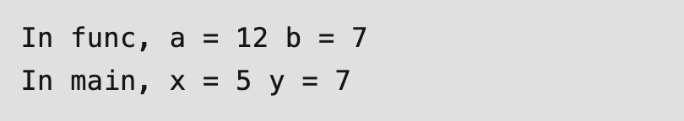
Example:
Output:
CSET333: Problem Solving Using C

Slide 21
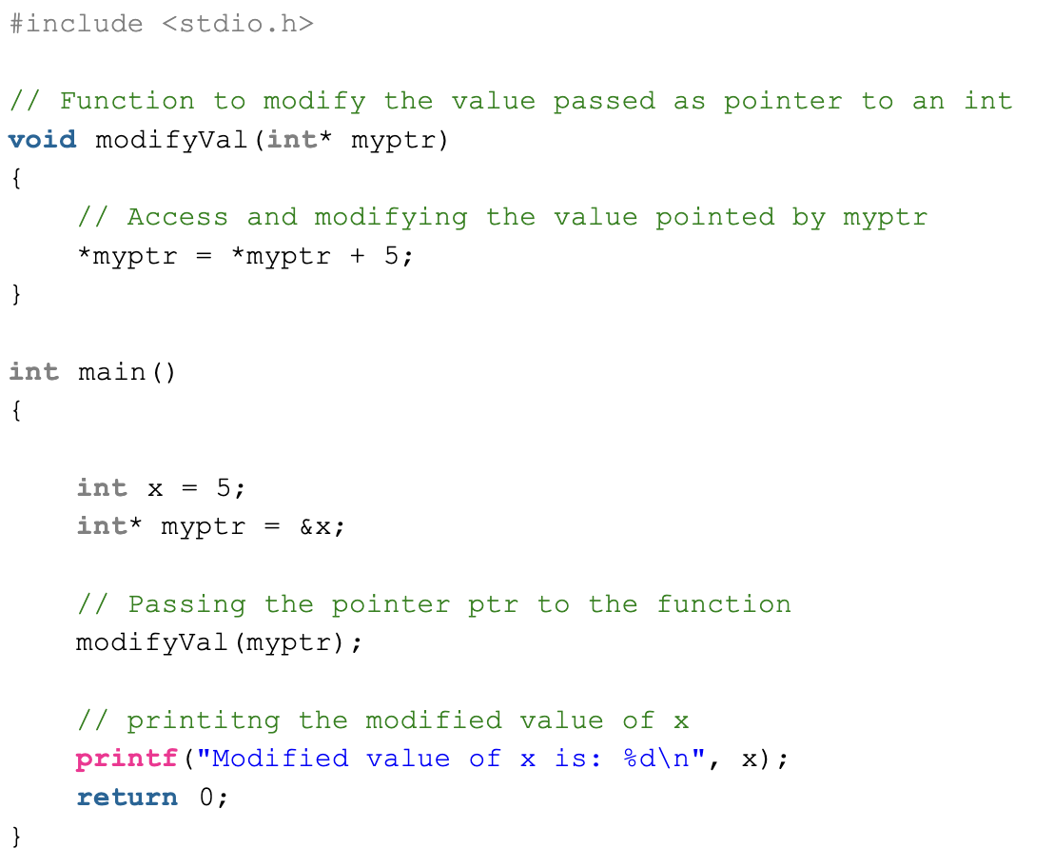
2. Pass by reference
This technique uses a pointer. In function we pass memory address (pointer) of a variable rather than passing the actual value of variable. This passing technique allows the function to access and modify the content at that particular memory location.
Example:
Output: Modified value of
x is: 10
CSET333: Problem Solving Using C

Slide 22
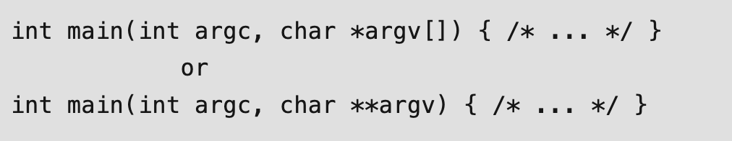
Command Line Arguments in C
Syntax
argc (ARGument Count) is an integer variable that stores the number of command-line arguments passed by the user including the name of the program. So if we pass a value to a program, the value of argc would be 2 (one for argument and one for program name)
The value of argc should be non-negative.
argv (ARGument Vector) is an array of character pointers listing all the arguments.
If argc is greater than zero, the array elements from argv[0] to argv[argc-1] will contain pointers to strings.
argv[0] is the name of the program , After that till argv[argc-1] every element is command -line arguments.
CSET333: Problem Solving Using C

Slide 23
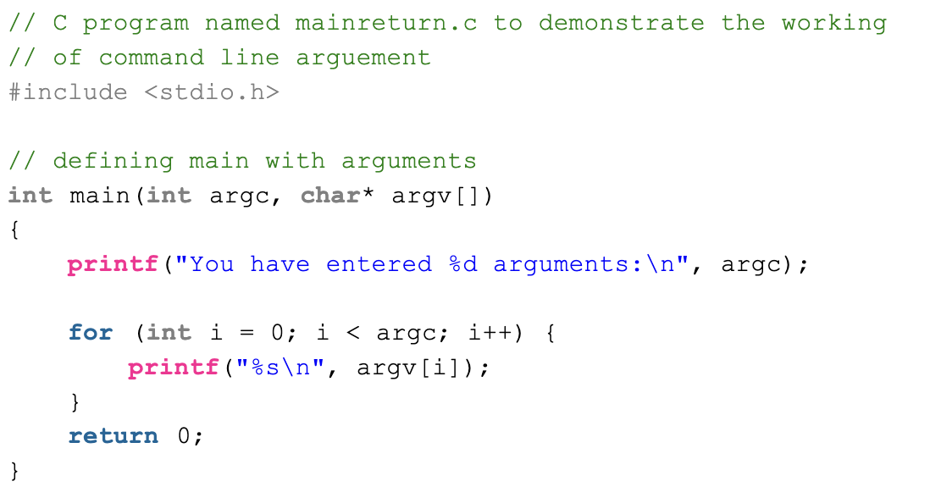
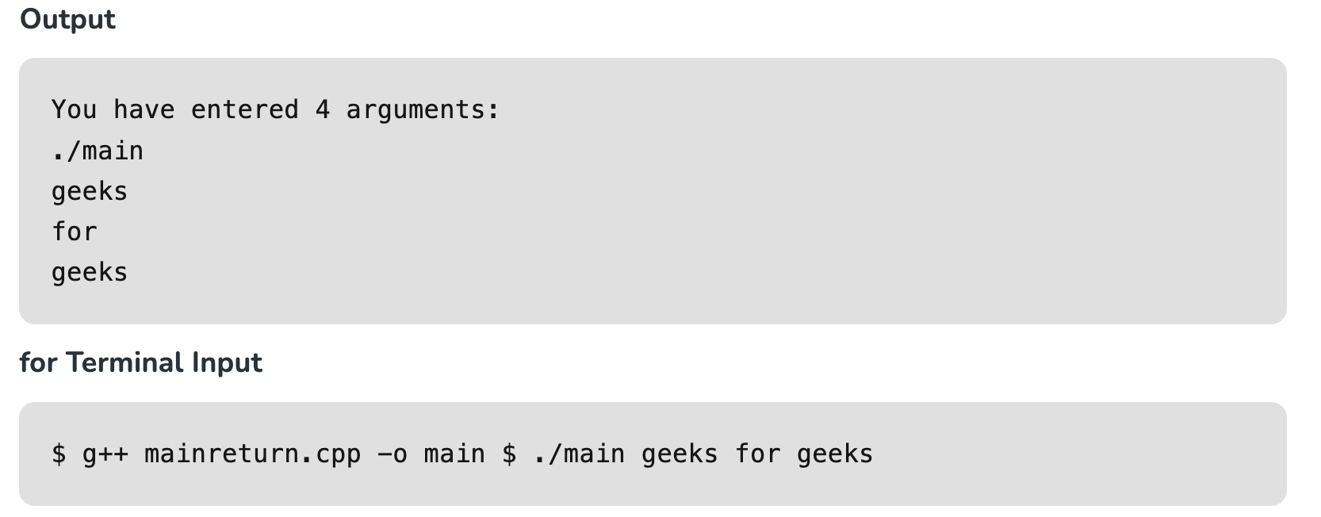
Example:
CSET333: Problem Solving Using C

Slide 24
Properties of Command Line Arguments in C
  They are passed to the main() function.
  They are parameters/arguments supplied to the program when it is invoked.
  They are used to control programs from outside instead of hard coding those values inside the code.
  argv[argc] is a NULL pointer.
  argv[0] holds the name of the program.
  argv[1] points to the first command line argument and argv[argc-1] points to the last argument.
CSET333: Problem Solving Using C

Slide 25
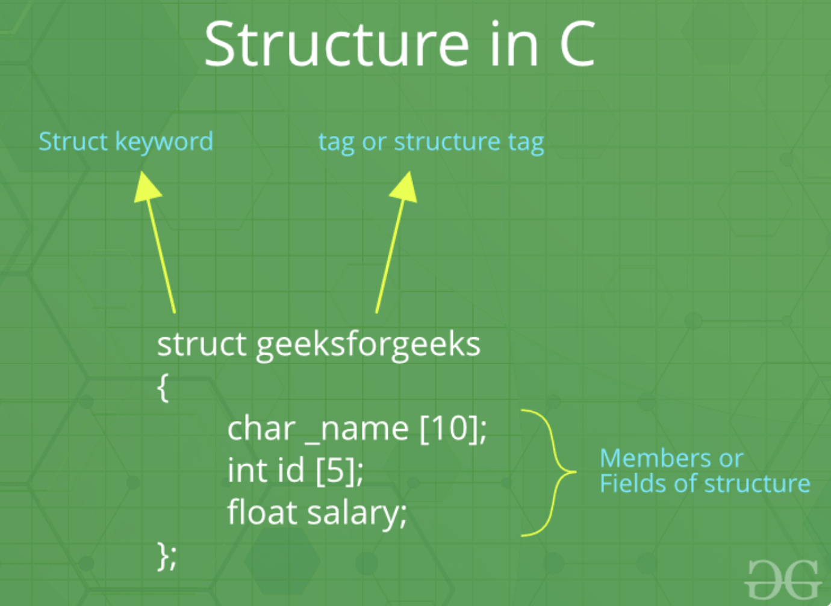
C Structures
The structure in C is a user-defined data type that can be used to group items of possibly different types into a single type.
The struct keyword is used to define the structure in the C programming language.
CSET333: Problem Solving Using C

Slide 26
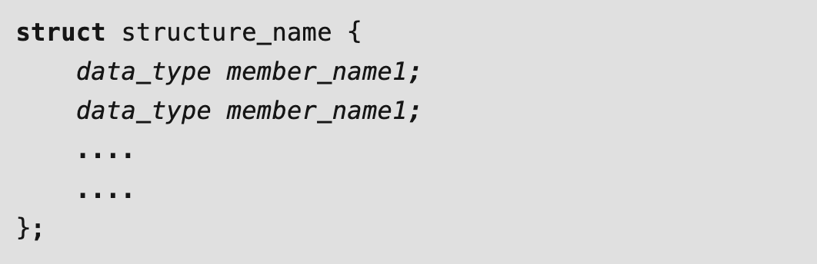
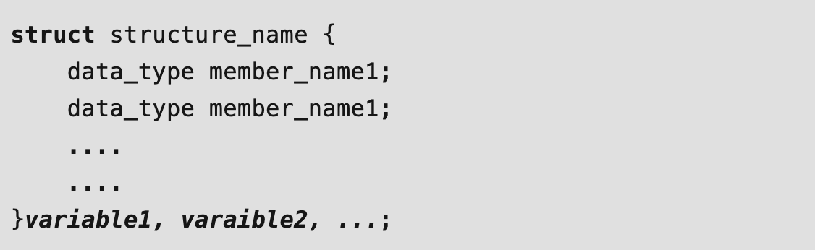
C Structure Declaration
Syntax
C Structure Definition
1. Structure Variable Declaration with Structure Template
CSET333: Problem Solving Using C

Slide 27
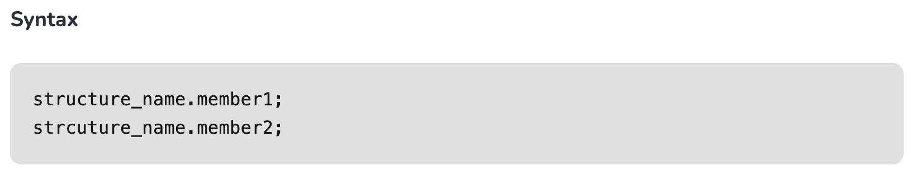
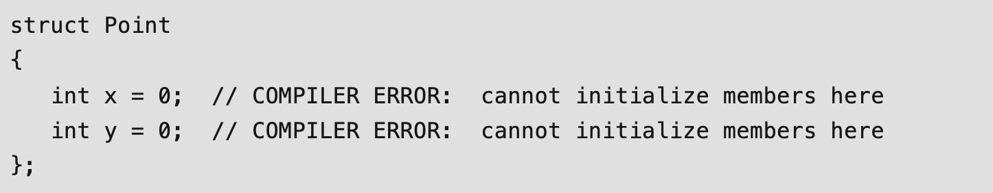
2. Structure Variable Declaration after Structure Template
Access Structure Members
Initialize Structure Members
CSET333: Problem Solving Using C

Slide 28
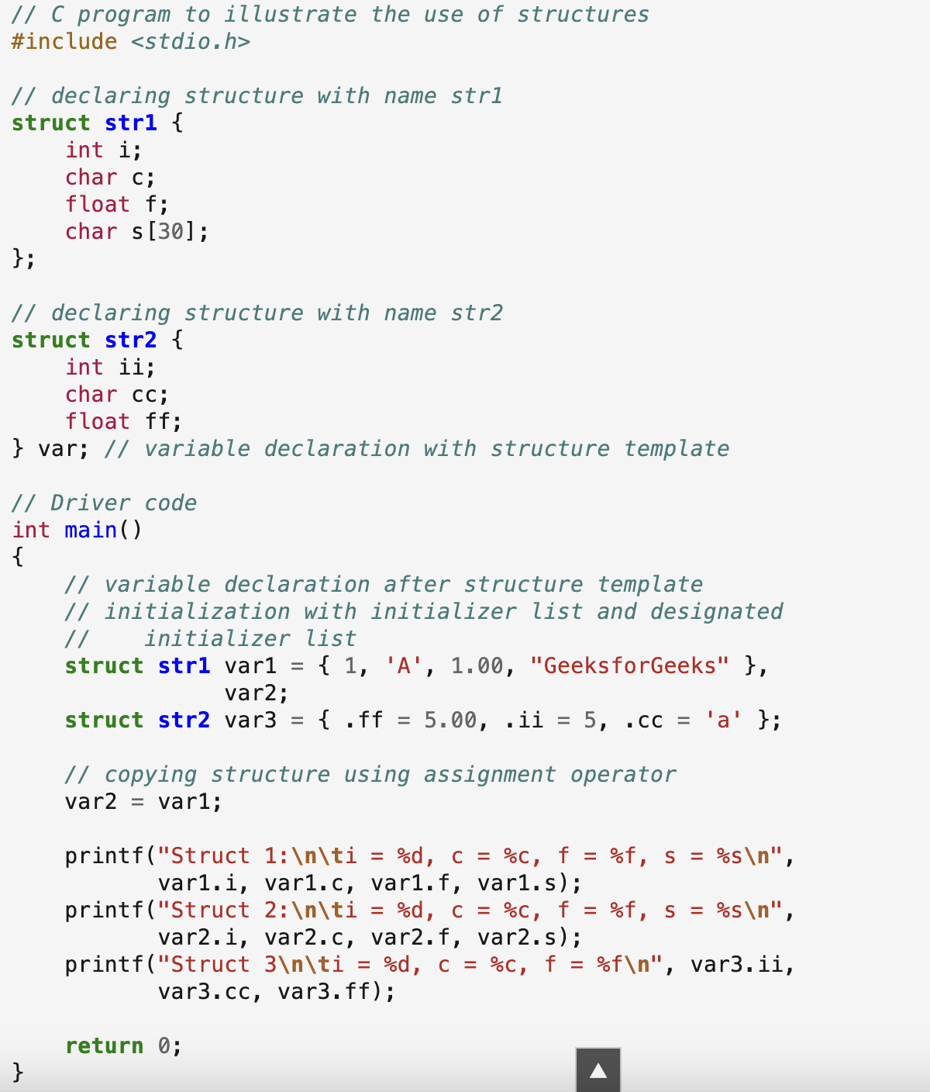
Example of Structure in C
CSET333: Problem Solving Using C

Slide 29
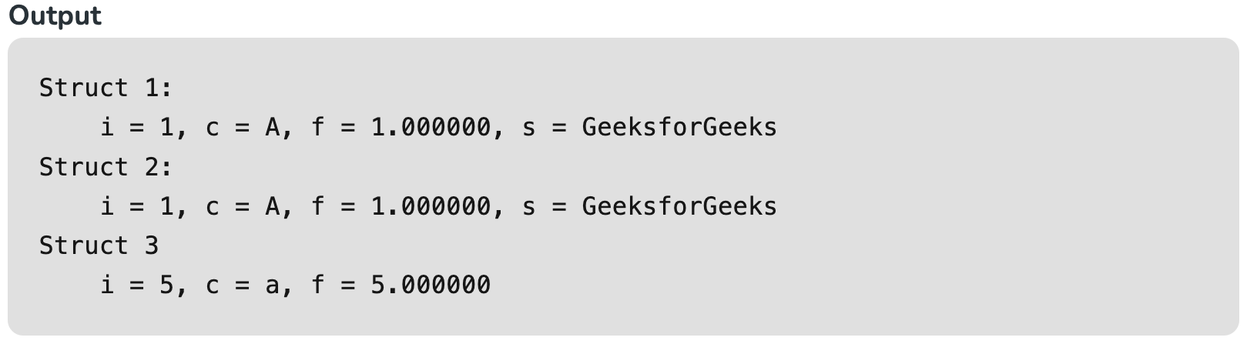
typedef for Structures
The typedef keyword is used to define an alias for the already existing datatype.
In structures, we have to use the struct keyword along with the structure name to define the variables.
Sometimes, this increases the length and complexity of the code.
We can use the typedef to define some new shorter name for the structure.
CSET333: Problem Solving Using C

Slide 30
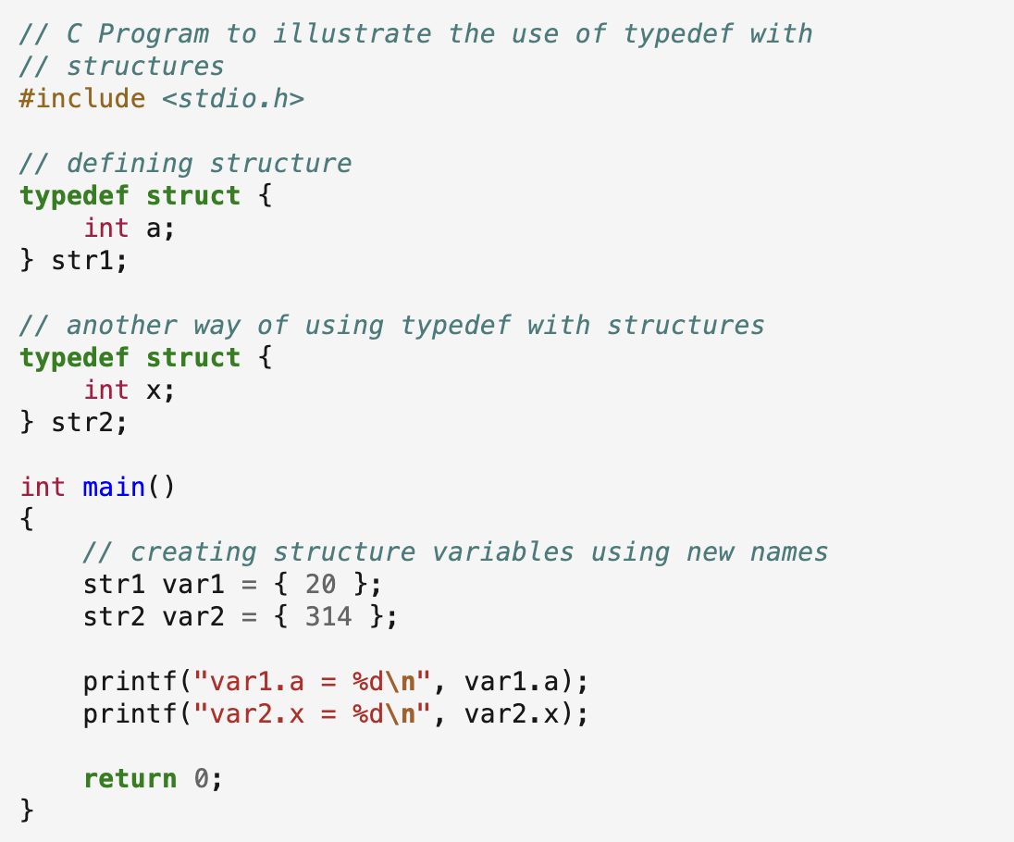
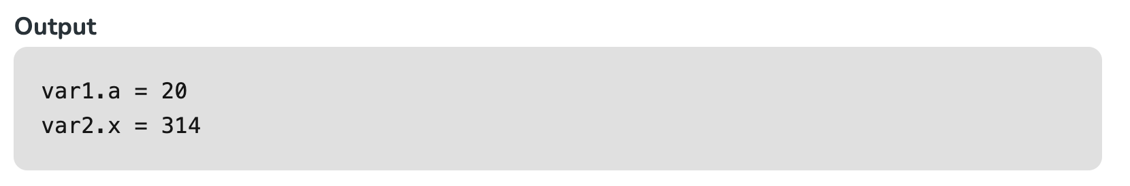
Example:
CSET333: Problem Solving Using C

Slide 31
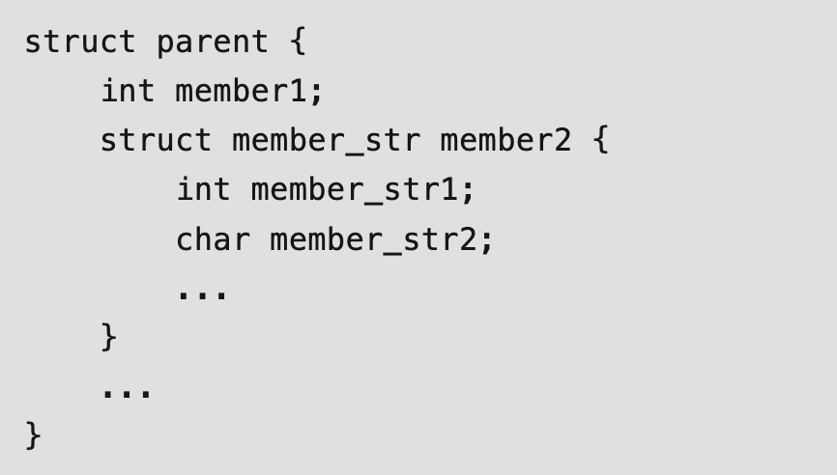
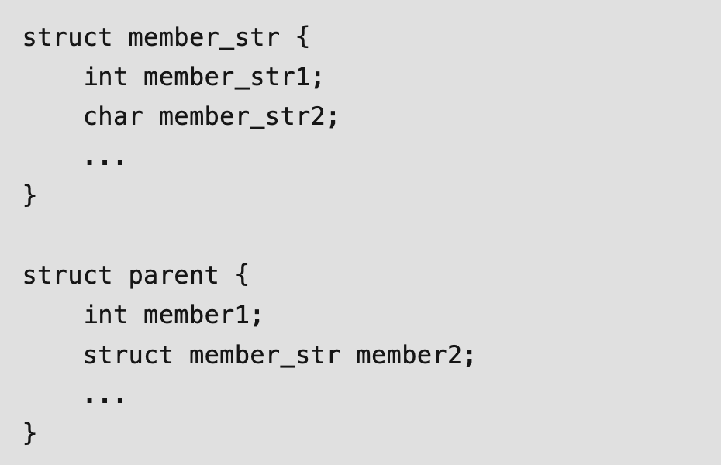
Nested Structures
1. Embedded Structure Nesting
2. Separate Structure Nesting
CSET333: Problem Solving Using C

Slide 32
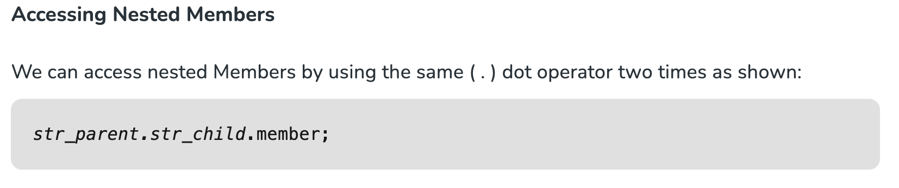
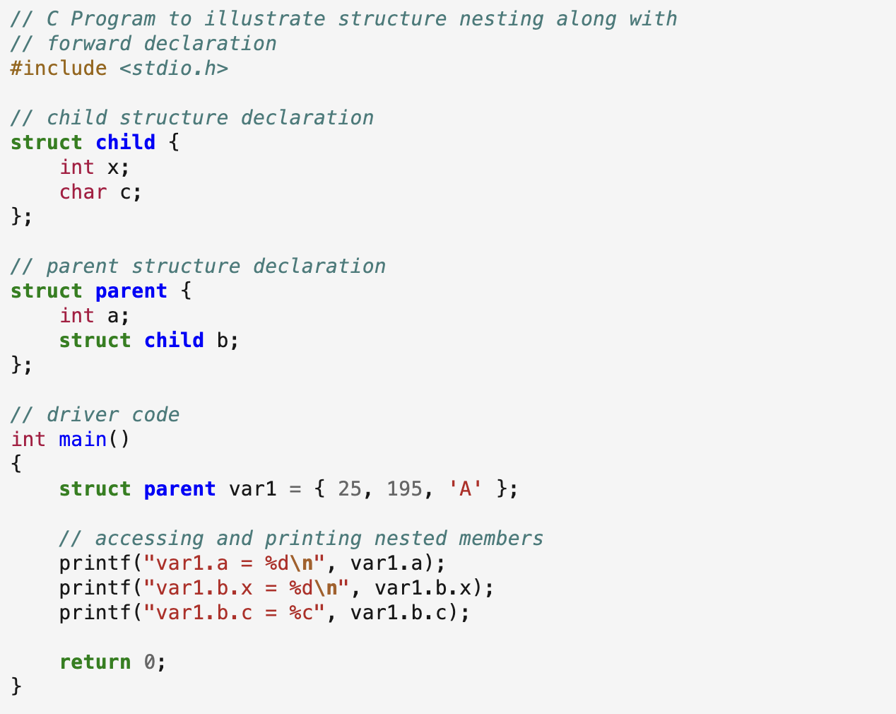
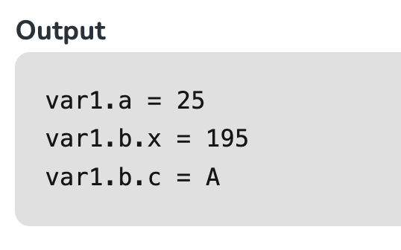
Example:
CSET333: Problem Solving Using C

Slide 33
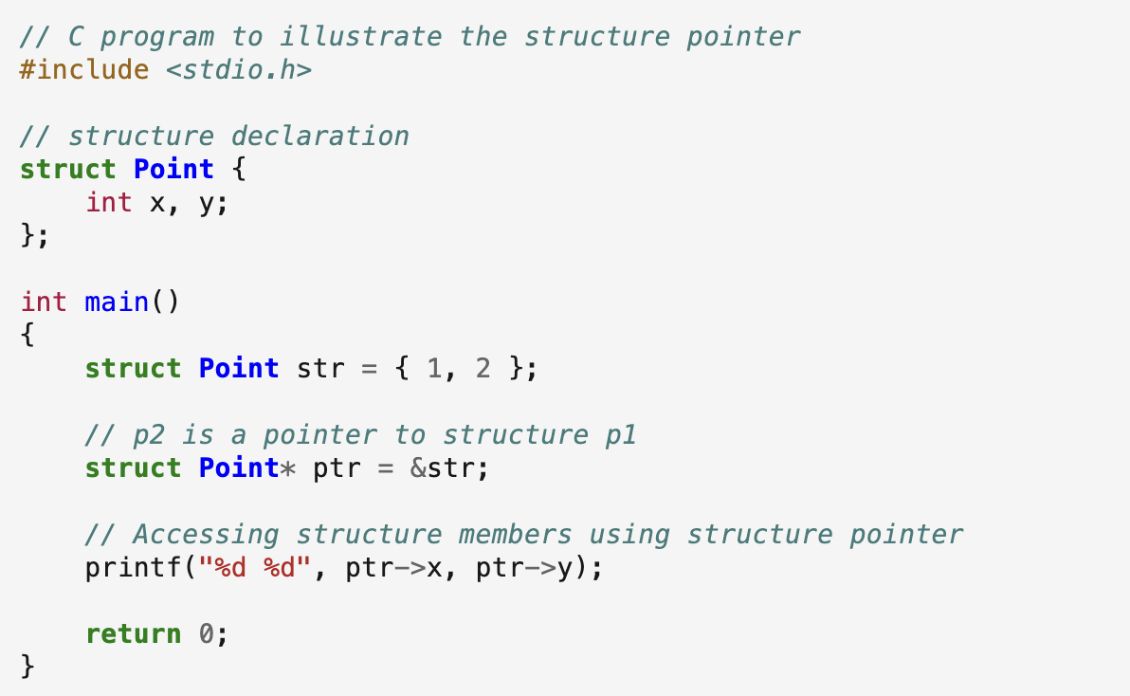
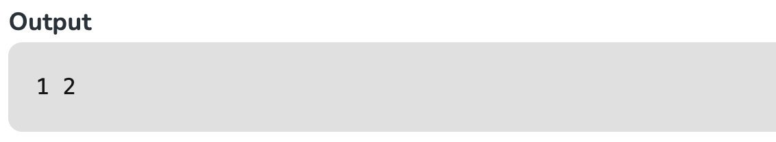
Structure Pointer in C
We can define a pointer that points to the structure like any other variable. Such pointers are generally called Structure Pointers.
CSET333: Problem Solving Using C

Slide 34
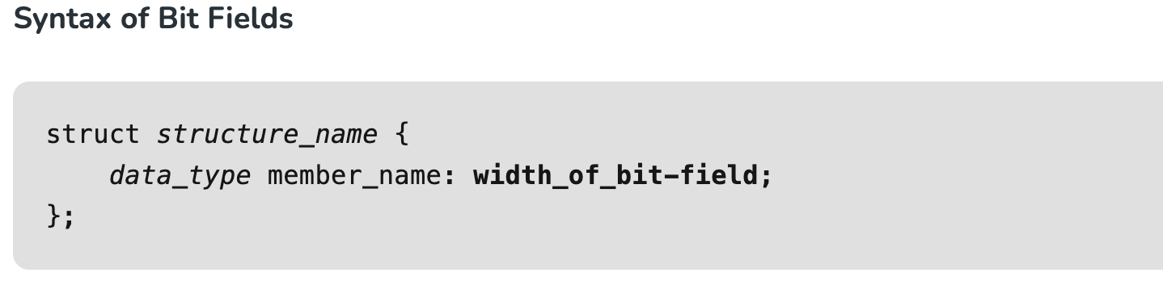
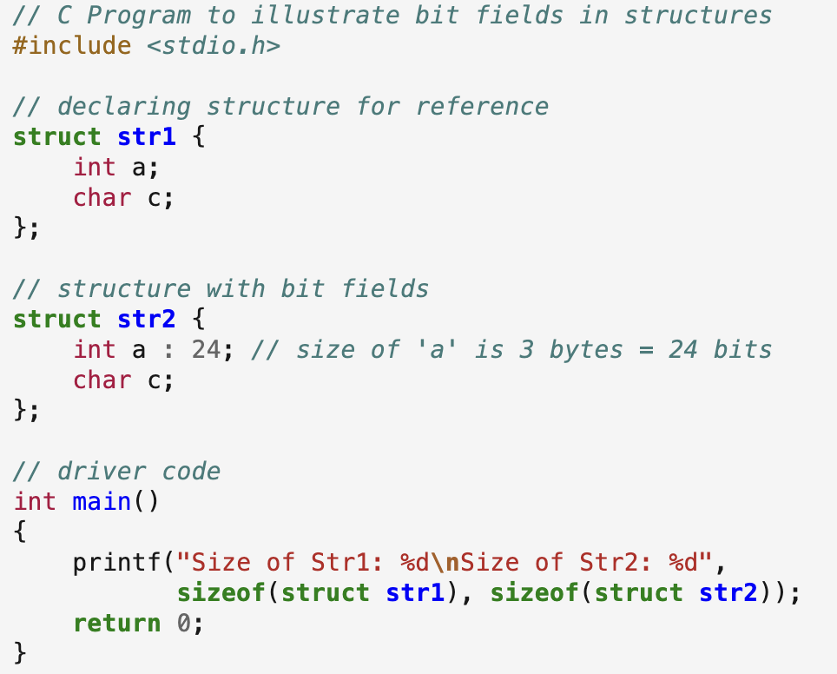
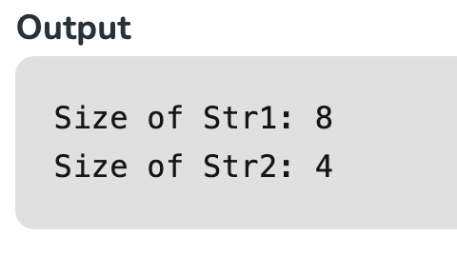
Bit Fields in Structures
Example
CSET333: Problem Solving Using C

Slide 35
OFFSETOF() macro
Syntax
Zero is casted to type of structure and required element’s address is accessed, which is casted to size_t.
As per standard size_t is of type unsigned int.
The overall expression results in the number of bytes after which the ELEMENT being placed in the structure.
For example, the following code returns 16 bytes (padding is considered on 32 bit machine) as displacement of the character variable c in the structure Pod.
CSET333: Problem Solving Using C

Slide 36
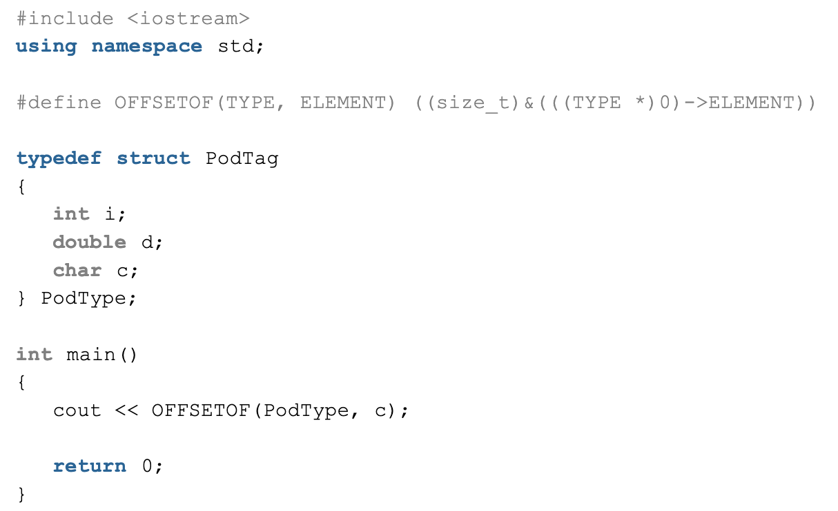


CSET333: Problem Solving Using C

Slide 37
Macros and its types in C
In C, a macro is a piece of code in a program that is replaced by the value of the macro.
Macro is defined by #define directive.
Whenever a macro name is encountered by the compiler, it replaces the name with the definition of the macro.
Macro definitions need not be terminated by a semi-colon(;).
CSET333: Problem Solving Using C

Slide 38


Example:
CSET333: Problem Solving Using C

Slide 39

Types Of Macros in C
There are two types of macros in C language:
1. Object-Like Macros
An object-like macro is a simple identifier that will be replaced by a code fragment. It is called object-like because it looks like an object in code that uses it. It is popularly used to replace a symbolic name with a numerical/variable represented as a constant.
Output
CSET333: Problem Solving Using C

Slide 40


2. Chain Macros
Macros inside macros are termed chain macros. In chain macros first of all parent macro is expanded then the child macro is expanded.
CSET333: Problem Solving Using C

Slide 41


3. Multi-Line Macros
An object-like macro could have a multi-line. So to create a multi-line macro you have to use backslash-newline.
CSET333: Problem Solving Using C

Slide 42


4. Function-Like Macros
These macros are the same as a function call. It replaces the entire code instead of a function name. Pair of parentheses immediately after the macro name is necessary. If we put a space between the macro name and the parentheses in the macro definition, then the macro will not work.
CSET333: Problem Solving Using C

Slide 43


C Unions
The Union is a user-defined data type in C language that can contain elements of the different data types just like structure.
But unlike structures, all the members in the C union are stored in the same memory location.
Due to this, only one member can store data at the given instance.
C Union Declaration
CSET333: Problem Solving Using C

Slide 44


Different Ways to Define a Union Variable
There are two methods using which we can define a union variable.
With Union Declaration
After Union Declaration
1. Defining Union Variable with Declaration
2. Defining Union Variable after Declaration
CSET333: Problem Solving Using C

Slide 45


Example of Union C
CSET333: Problem Solving Using C

Slide 46

Size of Union
The size of the union will always be equal to the size of the largest member of the array. All the less-sized elements can store the data in the same space without any overflow.
CSET333: Problem Solving Using C

Slide 47

CSET333: Problem Solving Using C

Slide 48


C typedef
The typedef is a keyword that is used to provide existing data types with a new name.
The C typedef keyword is used to redefine the name of already existing data types.
When names of datatypes become difficult to use in programs, typedef is used with user-defined datatypes, which behave similarly to defining an alias for commands.
C typedef Syntax
Example of typedef in C
CSET333: Problem Solving Using C

Slide 49


Example
CSET333: Problem Solving Using C

Slide 50
Use of typedef in C
Following are some common uses of the typedef in C programming:
  The typedef keyword gives a meaningful name to the existing data type which helps other users to understand the program more easily.
  It can be used with structures to increase code readability and we don’t have to type struct repeatedly.
  The typedef keyword can also be used with pointers to declare multiple pointers in a single statement.
  It can be used with arrays to declare any number of variables.
CSET333: Problem Solving Using C

Slide 51


1. typedef struct
typedef can also be used with structures in the C programming language. A new data type can be created and used to define the structure variable.
2. typedef with Pointers
typedef can also be used with pointers as it gives an alias name to the pointers. Typedef is very efficient while declaring multiple pointers in a single statement because pointers bind to the right on the simple declaration.
3. typedef with Array
typedef can also be used with an array to increase their count.
Example:
CSET333: Problem Solving Using C

Slide 52


C- TypeCasting
Typecasting in C is the process of converting one data type to another data type by the programmer using the casting operator during program design.
Syntax
Types of Type Casting in C
CSET333: Problem Solving Using C

Slide 53

1. Implicit Type Casting
Implicit type casting in C is used to convert the data type of any variable without using the actual value that the variable holds. It performs the conversions without altering any of the values which are stored in the data variable. Conversion of lower data type to higher data type will occur automatically.
Integer promotion will be performed first by the compiler. After that, it will determine whether two of the operands have different data types. Using the hierarchy below, the conversion would appear as follows if they both have varied data types:
CSET333: Problem Solving Using C

Slide 54
2. Explicit Type Casting
There are some cases where if the datatype remains unchanged, it can give incorrect output.
In such cases, typecasting can help to get the correct output and reduce the time of compilation.
In explicit type casting, we have to force the conversion between data types.
This type of casting is explicitly defined within the program.
CSET333: Problem Solving Using C

Slide 55


Example:
CSET333: Problem Solving Using C

Slide 56

C Pointers
A pointer is defined as a derived data type that can store the address of other C variables or a memory location. We can access and manipulate the data stored in that memory location using pointers.
Syntax of C Pointers
The above syntax is used to define a pointer to a variable. We can also define pointers to functions, structures, etc.
CSET333: Problem Solving Using C

Slide 57


1. Pointer Declaration
In pointer declaration, we only declare the pointer but do not initialize it. To declare a pointer, we use the ( * ) dereference operator before its name.
Example
The pointer declared here will point to some random memory address as it is not initialized. Such pointers are called wild pointers.
2. Pointer Initialization
Pointer initialization is the process where we assign some initial value to the pointer variable. We generally use the ( &: ampersand ) addressof operator to get the memory address of a variable and then store it in the pointer variable.
CSET333: Problem Solving Using C

Slide 58

3. Pointer Dereferencing
Dereferencing a pointer is the process of accessing the value stored in the memory address specified in the pointer. We use the same ( * ) dereferencing operator that we used in the pointer declaration.
CSET333: Problem Solving Using C

Slide 59
Types of Pointers in C
1. Integer Pointers
As the name suggests, these are the pointers that point to the integer values.
Syntax: int *ptr;
These pointers are pronounced as Pointer to Integer. Similarly, a pointer can point to any primitive data type. It can point also point to derived data types such as arrays and user-defined data types such as structures.
2. Array Pointer
Pointers and Array are closely related to each other. Even the array name is the pointer to its first element. They are also known as Pointer to Arrays. We can create a pointer to an array using the given syntax.
Syntax: char *ptr = &array_name;
CSET333: Problem Solving Using C

Slide 60
3. Structure Pointer
The pointer pointing to the structure type is called Structure Pointer or Pointer to Structure. It can be declared in the same way as we declare the other primitive data types.
Syntax: struct struct_name *ptr;
4. Function Pointers
Function pointers point to the functions. They are different from the rest of the pointers in the sense that instead of pointing to the data, they point to the code. Let’s consider a function prototype – int func (int, char), the function pointer for this function will be
Syntax: int (*ptr)(int, char);
5. NULL Pointer
The Null Pointers are those pointers that do not point to any memory location. They can be created by assigning a NULL value to the pointer. A pointer of any type can be assigned the NULL value.
Syntax: data_type *pointer_name = NULL; or pointer_name = NULL
CSET333: Problem Solving Using C

Slide 61

Indirection operator/Dereference operator (*)
The indirection/ dereference operator is a unary operator that returns the value of the variable present at the given address. It is completely opposite to the address-of operator. It is spelled as a value pointed at the address.
Example:
Output
CSET333: Problem Solving Using C
The value stored at the variable price is Rs : 3899

Slide 62
Pointer to an Array
Syntax:
data_type (*var_name)[size_of_array];
Here:
  data_type is the type of data that the array holds.
  var_name is the name of the pointer variable.
  size_of_array is the size of the array to which the pointer will point.
Example
int (*ptr)[10];
Here ptr is pointer that can point to an array of 10 integers. Since subscript have higher precedence than indirection, it is necessary to enclose the indirection operator and pointer name inside parentheses. Here the type of ptr is ‘pointer to an array of 10 integers.
CSET333: Problem Solving Using C

Slide 63

The following figure shows the pointer p and ptr. The darker arrow denotes a pointer to an array.
On dereferencing a pointer expression we get a value pointed to by that pointer expression. The pointer to an array points to an array, so on dereferencing it, we should get the array, and the name of the array denotes the base address. So whenever a pointer to an array is dereferenced, we get the base address of the array to which it points.
CSET333: Problem Solving Using C

Slide 64


Function Pointer in C
In C, like normal data pointers (int *, char *, etc), we can have pointers to functions. Following is a simple example that shows declaration and function call using function pointer.
Example:
CSET333: Problem Solving Using C

Slide 65
Following are some interesting facts about function pointers:
1) Unlike normal pointers, a function pointer points to code, not data. Typically a function pointer stores the start of executable code.
2) Unlike normal pointers, we do not allocate de-allocate memory using function pointers.
3) A function’s name can also be used to get functions’ address. For example, in the below program, we have removed address operator ‘&’ in assignment. We have also changed function call by removing *, the program still works.
4) Like normal pointers, we can have an array of function pointers. Below example in point 5 shows syntax for array of pointers.
5) Function pointer can be used in place of switch case. For example, in below program, user is asked for a choice between 0 and 2 to do different tasks.
6) Like normal data pointers, a function pointer can be passed as an argument and can also be returned from a function.
CSET333: Problem Solving Using C

Slide 66

Structure Pointer in C
A structure pointer is defined as the pointer which points to the address of the memory block that stores a structure known as the structure pointer. Complex data structures like Linked lists, trees, graphs, etc. are created with the help of structure pointers. The structure pointer tells the address of a structure in memory by pointing the variable to the structure variable.
CSET333: Problem Solving Using C

Slide 67
Accessing the Structure Member with the Help of Pointers
There are two ways to access the members of the structure with the help of a structure pointer:
With the help of (*) asterisk or indirection operator and (.) dot operator.
With the help of ( -> ) Arrow operator.
CSET333: Problem Solving Using C

Slide 68
Array of Pointers in C
In C, a pointer array is a homogeneous collection of indexed pointer variables that are references to a memory location. It is generally used in C Programming when we want to point at multiple memory locations of a similar data type in our C program. We can access the data by dereferencing the pointer pointing to it.
Syntax: pointer_type *array_name [array_size];
Here,
  pointer_type: Type of data the pointer is pointing to.
  array_name: Name of the array of pointers.
  array_size: Size of the array of pointers.
CSET333: Problem Solving Using C

Slide 69


Example
CSET333: Problem Solving Using C

Slide 70
Application of Array of Pointers
An array of pointers is useful in a wide range of cases. Some of these applications are listed below:
  It is most commonly used to store multiple strings.
  It is also used to implement LinkedHashMap in C and also in the Chaining technique of collision resolving in Hashing.
  It is used in sorting algorithms like bucket sort.
  It can be used with any pointer type so it is useful when we have separate declarations of multiple entities and we want to store them in a single place.
Disadvantages of Array of Pointers
  Higher Memory Consumption: An array of pointers requires more memory as compared to plain arrays because of the additional space required to store pointers.
  Complexity: An array of pointers might be complex to use as compared to a simple array.
  Prone to Bugs: As we use pointers, all the bugs associated with pointers come with it so we need to handle them carefully.
CSET333: Problem Solving Using C

Slide 71

Passing pointers to functions
A pointer to a function is passed in this example. As an argument, a pointer is passed instead of a variable and its address is passed instead of its value. As a result, any change made by the function using the pointer is permanently stored at the address of the passed variable. In C, this is referred to as call by reference.
Output
Values before swap function are: 10, 20
Values after swap function are: 20, 10
CSET333: Problem Solving Using C

